Slide 1

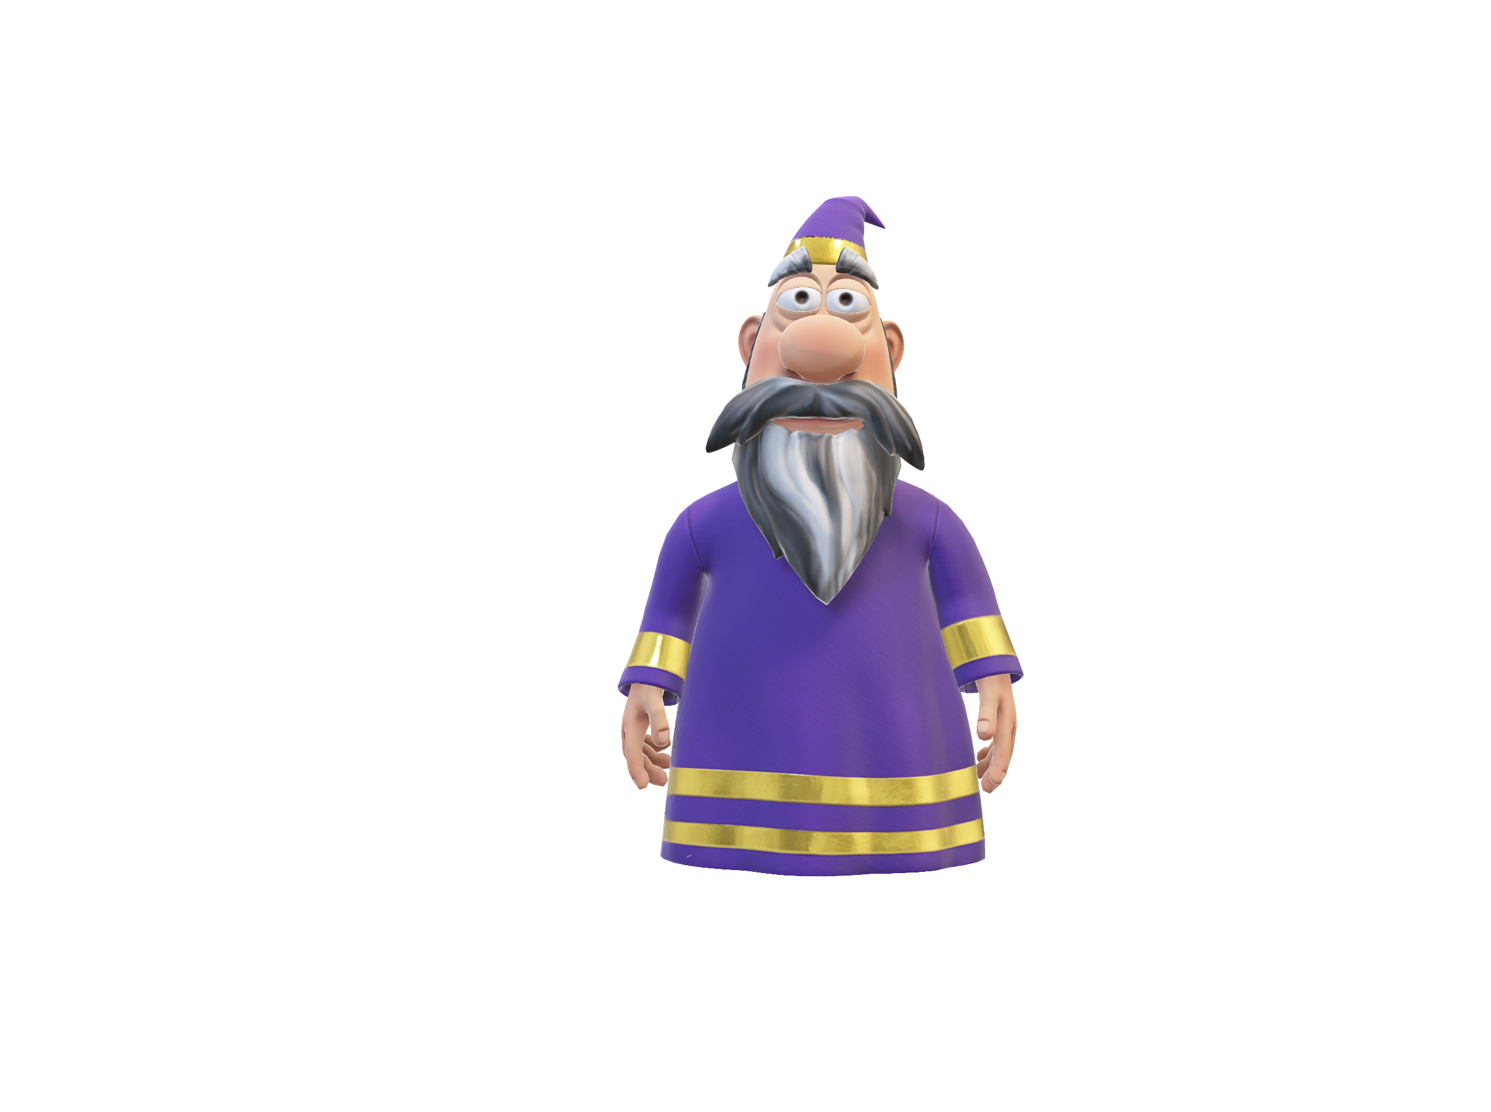

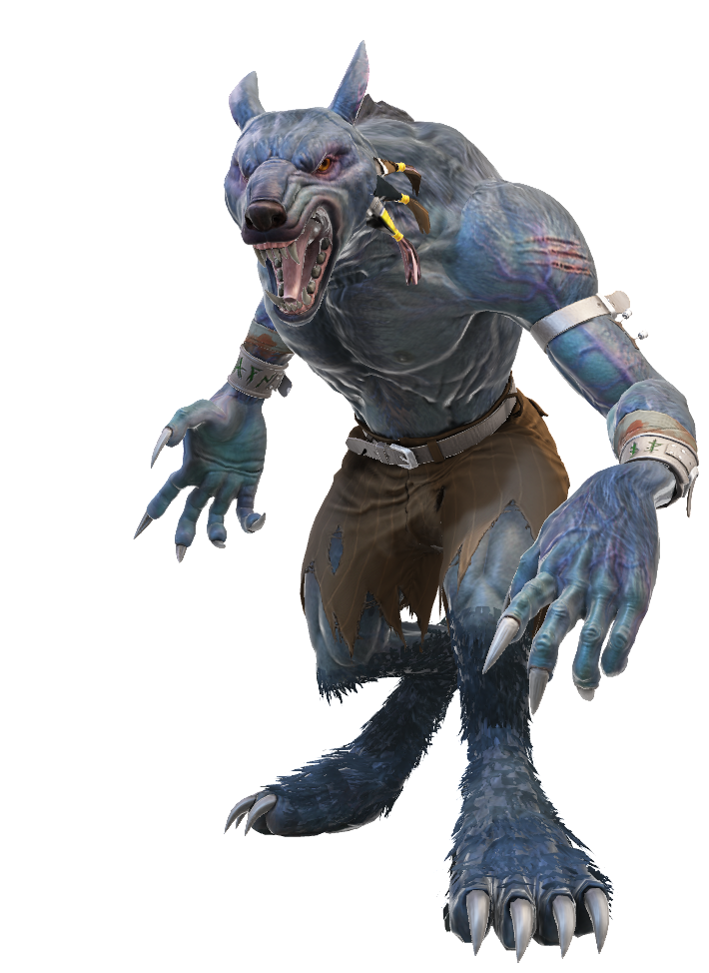
The quantum werewolf
By Ludovic Marcotte, Louis-Félix Vigneux, Wilhem Harvey and Rémy Lyscar
« compile moi si tu peux »
For the iQuCodeFest

Slide 2
The goal of the game
Two win conditions:
The village (non-werewolves players) killed all of the werewolves.
The werewolves compose more than half of the players alive.
Begin the game
Night Phase
Day phase

Slide 3

The core mechanic
Player alife
Qubit representing a player
Two phases:
The night phase
The day phase
Qubit represent the life of a player:
Player lives if state measured is |0>
Player dies if state measured is |1>
Player dead

Slide 4
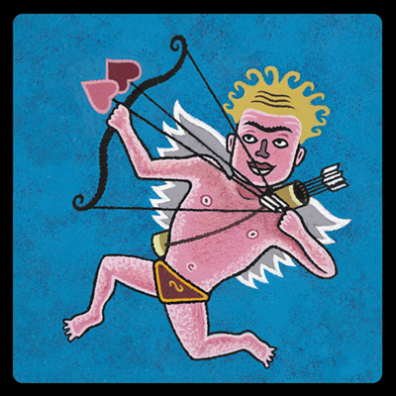

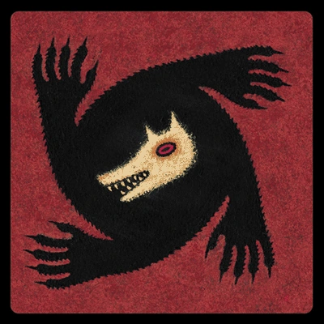


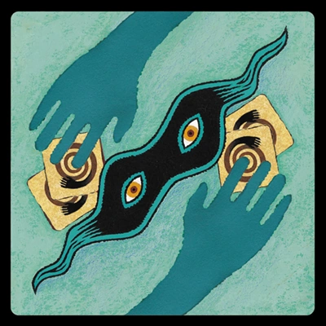
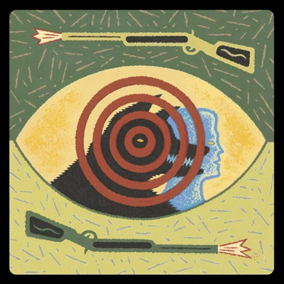



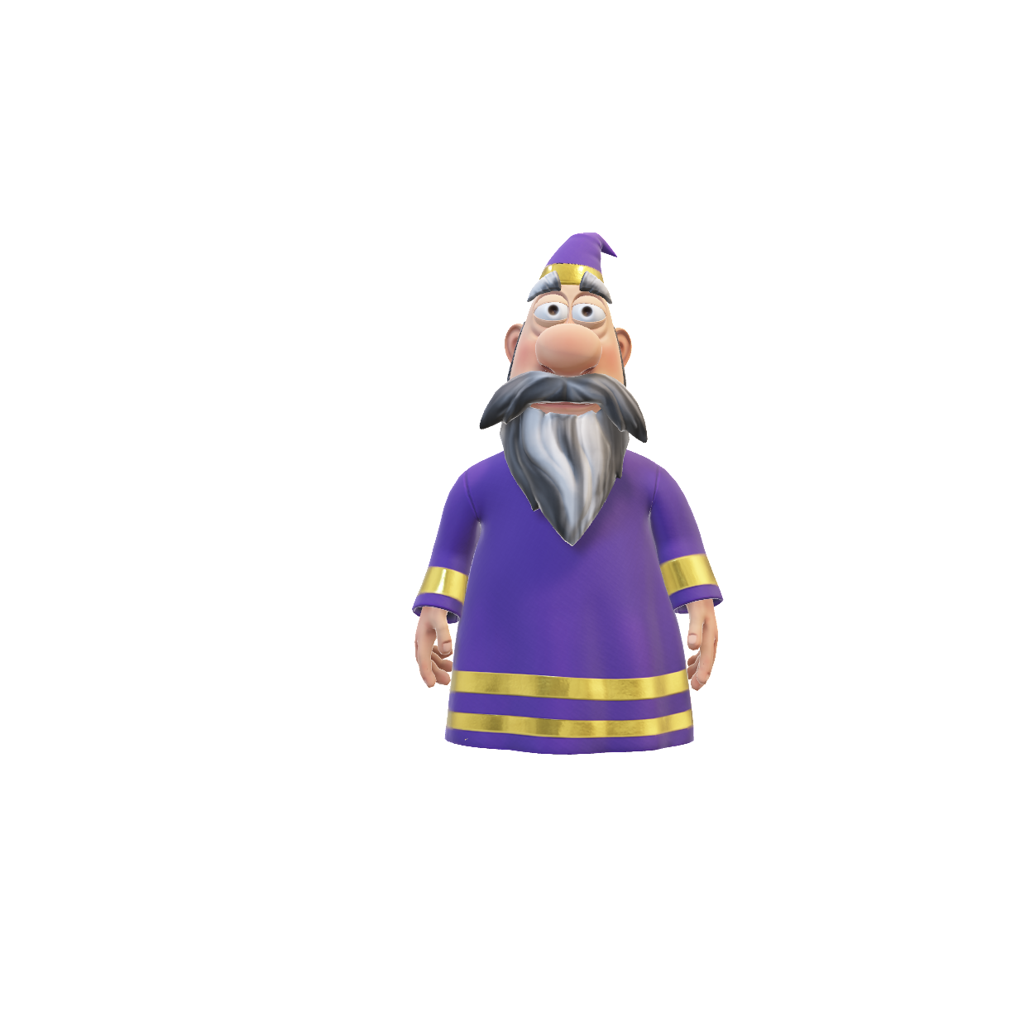
The roles
Order of the roles:
The cupid (1st turn only)
The seek
The werewolves
The witch
The saviour
The thief
* Other roles:
The hunter
The captain
The villagers

Slide 5
Explication of the quantum roles
Werewolfs
Little attack gate
The witch
Rx(π/3)
Attack gate
Rx(2π/3)
Or
Little save gate
Rx(-π/3)

Slide 6
Explication of the quantum roles
The cupid
The saviour
Entangle two players
Reset to |0>
|0><0|

Slide 7
Explication of the quantum roles
The hunter
The thief
Big attack gate when
he dies
Swap gate
Rx(ϴ)
90% probability for the targeted player to die

Slide 8
Explication of the classical roles
The captain
The seek
The villager

Slide 9
Explication of the night phase
Qubits are measured in the morning
in the Z-basis.
Gates are applied during the night phase.
Rx(2π/3)
Rx(-π/3)
𝛼|0> + β|1>
Player 1 (role)
|0>
|1>
Player 2 (role)
|0>
|0>
𝛼|0> + β|1>
|0><0|
|0>
|1>
Player 3 (role)
𝛼|0> + β|1>
Player 4 (role)
|0>
|0>
𝛼|0> + β|1>
…
...

Slide 10
The vote test: instant check to see if the player dies.
|0>
Voted player
Rx(2π/3)
|0>
|0> or |1>, lives or die
|1>

Slide 11
Conclusion (example if time)

